Slide 1
Artificial Intelligence Lecture 1: Introduction
By
Rimiru R. M.

Slide 2
Today’s Lecture overview
What is intelligence? What is artificial intelligence?
A very brief history of AI
Modern successes: Stanley the driving robot; Deep Blue the chess game player; IBM’s Watson computer
An AI scorecard
How much progress has been made in different aspects of AI
AI in practice
Successful applications
The rational agent view of AI

Slide 3
What is Intelligence?
Intelligence:
“the capacity to learn and solve problems” (Websters dictionary)
in particular,
the ability to solve novel problems
the ability to act rationally
the ability to act like humans
Artificial Intelligence
Concerned with building and/or understanding intelligent entities or agents
2 main approaches: “engineering” versus “cognitive modeling”

Slide 4
Types of Intelligence
According to Howard Gardner’s multiple intelligence theory, there are various types of intelligence viz:
General intelligence: -
Abilities that allow us to be flexible and adaptive thinkers, not necessarily tied to acquired knowledge.
Linguistic-verbal intelligence: -
Use words and language in various forms / Ability to manipulate language to express oneself poetically
Logical-Mathematical intelligence: -
Ability to detect patterns / Approach problems logically / Reason deductively
Musical intelligence: -
Recognize nonverbal sounds: pitch, rhythm, and tonal patterns
Spatial intelligence: -
Typically thinks in images and pictures / Used in both arts and sciences

Slide 5
Types of Intelligence (2)
Intrapersonal intelligence: -
Ability to understand oneself, including feelings and motivations / Can discipline themselves to accomplish a wide variety of tasks
Interpersonal intelligence: -
Ability to "read people"—discriminate among other individuals especially their moods, intentions, motivations; / Adept at group work, typically assume a leadership role.
Naturalist intelligence: -
Ability to recognize and classify living things like plants, animals
Bodily-Kinesthetic intelligence: -
Use one’s mental abilities to coordinate one’s own bodily movements

Slide 6
Types of Intelligence (3)
Note:
Understanding the various types of intelligence provides theoretical foundations for recognizing different talents and abilities in people
"What makes life interesting, however, is that we don’t have the same strength in each intelligence area, and we don’t have the same amalgam of intelligences. Just as we look different from one another and have different kinds of personalities, we also have different kinds of minds."

Slide 7
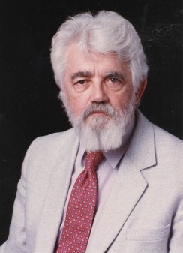
What is Artificial Intelligence? (John McCarthy, Stanford University)
What is artificial intelligence?
It is the science and engineering of making intelligent machines, especially intelligent computer programs. It is related to the similar task of using computers to understand human intelligence, but AI does not have to confine itself to methods that are biologically observable or plausible.
Yes, but what is intelligence?
Intelligence is the computational part of the ability to achieve goals in the world. Varying kinds and degrees of intelligence occur in people, many animals and some machines.
Isn't there a solid definition of intelligence that doesn't depend on relating it to human intelligence?
Not yet. The problem is that we cannot yet characterize in general what kinds of computational procedures we want to call intelligent. We understand some of the mechanisms of intelligence and not others.
More in: http://www-formal.stanford.edu/jmc/whatisai/node1.html

Slide 8
What is AI? (2)
There is no agreed definition of the term artificial intelligence. However, there are various definitions that have been proposed. These are considered below:
AI is a study in which computer systems are made that think like human beings. Haugeland, 1985 & Bellman, 1978.
AI is a study in which computer systems are made that act like people.
AI is the art of creating computers that perform functions that require intelligence when performed by people. Kurzweil, 1990.
AI is the study of how to make computers do things, which at the moment people are better at. Rich & Knight
AI is the study of computations that make it possible to perceive, reason and act. Winston, 1992
AI is considered to be a study that seeks to explain and emulate intelligent behaviour in terms of computational processes. Schalkeoff, 1990.
AI is considered to be a branch of computer science that is concerned with the automation of intelligent behavior. Luger & Stubblefield, 1993.

Slide 9
What is AI? (3)
Artificial Intelligence is the development of systems that exhibit the characteristics we associate with intelligence in human behavior:
perception,
natural language processing,
reasoning,
planning,
problem solving,
learning and adaptation,
etc.

Slide 10
What’s involved in Intelligence?
Ability to interact with the real world
to perceive, understand, and act
e.g., speech recognition and understanding and synthesis
e.g., image understanding
e.g., ability to take actions, have an effect
Reasoning and Planning
modeling the external world, given input
solving new problems, planning, and making decisions
ability to deal with unexpected problems, uncertainties
Learning and Adaptation
we are continuously learning and adapting
our internal models are always being “updated”
e.g., a baby learning to categorize and recognize animals

Slide 11
Academic Disciplines relevant to AI
Philosophy Logic, methods of reasoning, mind as physical system, foundations of learning, language, rationality.
Mathematics Formal representation and proof, algorithms, computation, (un)decidability, (in)tractability
Probability/Statistics modeling uncertainty, learning from data
Economics utility, decision theory, rational economic agents
Neuroscience neurons as information processing units.
Psychology/ how do people behave, perceive, process cognitive
Cognitive Science information, represent knowledge.
Computer building fast computers engineering
Control theory design systems that maximize an objective function over time
Linguistics knowledge representation, grammars

Slide 12
Brief History of AI (1)
1940~1950
Programs that perform elementary reasoning tasks
Alan Turing: First modern article dealing with the possibility of mechanizing human-style intelligence
McCulloch and Pitts: Show that it is possible to compute any computable function by networks of artificial neurons.
1956
Coined the name “Artificial Intelligence”
Frege: Predicate calculus = Begriffsschrift = “concept writing”
McCarthy: Predicate calculus: language for representing and using knowledge in a system called “advice taker”
Perceptron for learning and for pattern recognition [Rosenblatt]

Slide 13
Brief History of AI (2)
1960~1970
Problem representations, search techniques, and general heuristics
Simple puzzle solving, game playing, and information retrieval
Chess, Checkers, Theorem proving in plane geometry
GPS (General Problem Solver)

Slide 14
Brief History of AI (3)
Late 1970 ~ early 1980
Development of more capable programs that contained the knowledge required to mimic expert human performance
Methods of representing problem-specific knowledge
DENDRAL
Input: chemical formula, mass spectrogram analyses
Output: predicting the structure of organic molecules
Expert Systems
Medical diagnoses

Slide 15
Brief History of AI (4)
DEEP BLUE (1997/5/11) (Kasparov)
Chess game playing program
Human Intelligence
Ability to perceive/analyze a visual scene
Roberts
Ability to understand and generate language
Winograd: Natural language understanding system
LUNAR system: answer spoken English questions about rock samples collected from the moon

Slide 16
Brief History of AI (5)
Neural Networks
Late 1950s: Rosenblatt
1980s: important class of nonlinear modeling tools
AI research ()
Neural networks + animation approach: problems of connecting symbolic processes to the sensors and effectors of robots in physical environments
Robots and Softbots (Agents)

Slide 17
Summary of History of AI(1)
1943: early beginnings
McCulloch & Pitts: Boolean circuit model of brain
1950: Turing
Turing's "Computing Machinery and Intelligence“
1956: birth of AI
Dartmouth meeting: "Artificial Intelligence“ name adopted
1950s: initial promise
Early AI programs, including
Samuel's checkers program
Newell & Simon's Logic Theorist
1955-65: “great enthusiasm”
Newell and Simon: GPS, general problem solver
Gelertner: Geometry Theorem Prover
McCarthy: invention of LISP

Slide 18
Summary of History of AI(2)
1966—73: Reality dawns
Realization that many AI problems are intractable
Limitations of existing neural network methods identified
Neural network research almost disappears
1969—85: Adding domain knowledge
Development of knowledge-based systems
Success of rule-based expert systems,
E.g., DENDRAL, MYCIN
But were brittle and did not scale well in practice
1986-- Rise of machine learning
Neural networks return to popularity
Major advances in machine learning algorithms and applications
1990-- Role of uncertainty
Bayesian networks as a knowledge representation framework
1995-- AI as Science
Integration of learning, reasoning, knowledge representation
AI methods used in vision, language, data mining, etc

Slide 19
Success Stories
Deep Blue defeated the reigning world chess champion Garry Kasparov in 1997
AI program proved a mathematical conjecture (Robbins conjecture) unsolved for decades
During the 1991 Gulf War, US forces deployed an AI logistics planning and scheduling program that involved up to 50,000 vehicles, cargo, and people
NASA's on-board autonomous planning program controlled the scheduling of operations for a spacecraft
Proverb solves crossword puzzles better than most humans
Robot driving: DARPA grand challenge 2003-2007
2006: face recognition software available in consumer cameras

Slide 20
Example: DARPA Grand Challenge
Grand Challenge
Cash prizes ($1 to $2 million) offered to first robots to complete a long course completely unassisted
Stimulates research in vision, robotics, planning, machine learning, reasoning, etc
2004 Grand Challenge:
150 mile route in Nevada desert
Furthest any robot went was about 7 miles
… but hardest terrain was at the beginning of the course
2005 Grand Challenge:
132 mile race
Narrow tunnels, winding mountain passes, etc
Stanford 1st, CMU 2nd, both finished in about 6 hours

Slide 21
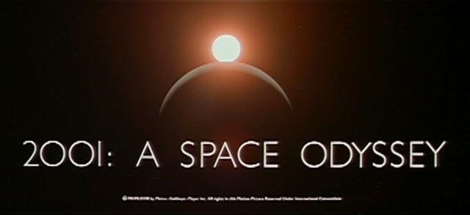
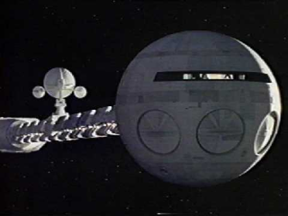
HAL: from the movie 2001
2001: A Space Odyssey
classic science fiction movie from 1969
HAL
part of the story centers around an intelligent computer called HAL
HAL is the “brains” of an intelligent spaceship
in the movie, HAL can
speak easily with the crew
see and understand the emotions of the crew
navigate the ship automatically
diagnose on-board problems
make life-and-death decisions
display emotions
In 1969 this was science fiction: is it still science fiction?

Slide 22
Hal and AI
HAL’s Legacy: 2001’s Computer as Dream and Reality
MIT Press, 1997, David Stork (ed.)
discusses
HAL as an intelligent computer
are the predictions for HAL realizable with AI today?
Materials online at
http://mitpress.mit.edu/e-books/Hal/contents.html
The website contains
full text and abstracts of chapters from the book
links to related material and AI information
sound and images from the film

Slide 23
What might be involved in building a computer like Hal….
What are the components that might be useful?
Fast hardware?
Chess-playing at grandmaster level?
Speech interaction?
speech synthesis
speech recognition
speech understanding
Image recognition and understanding ?
Learning?
Planning and decision-making?

Slide 24
Can we build hardware as complex as the brain?
How complicated is our brain?
a neuron, or nerve cell, is the basic information processing unit
estimated to be on the order of 10 ¹² neurons in a human brain
many more synapses (10 ¹⁴) connecting these neurons
cycle time: 10 ⁻³ seconds (1 millisecond)
How complex can we make computers?
10⁸ or more transistors per CPU
supercomputer: hundreds of CPUs, 10¹² bits of RAM
cycle times: order of 10 ⁻ ⁹ seconds
Conclusion
YES: in the near future we can have computers with as many basic processing elements as our brain, but with
far fewer interconnections (wires or synapses) than the brain
much faster updates than the brain
but building hardware is very different from making a computer behave like a brain!

Slide 26
Can Computers Talk?
This is known as “speech synthesis”
translate text to phonetic form
e.g., “fictitious” -> fik-tish-es
use pronunciation rules to map phonemes to actual sound
e.g., “tish” -> sequence of basic audio sounds
Difficulties
sounds made by this “lookup” approach sound unnatural
sounds are not independent
e.g., “act” and “action”
modern systems (e.g., at AT&T) can handle this pretty well
a harder problem is emphasis, emotion, etc
humans understand what they are saying
machines don’t: so they sound unnatural
Conclusion:
NO, for complete sentences
YES, for individual words

Slide 27
Can Computers Recognize Speech?
Speech Recognition:
mapping sounds from a microphone into a list of words
classic problem in AI, very difficult
“Lets talk about how to wreck a nice beach”
(I really said “________________________”)
Recognizing single words from a small vocabulary
systems can do this with high accuracy (order of 99%)
e.g., directory inquiries
limited vocabulary (area codes, city names)
computer tries to recognize you first, if unsuccessful hands you over to a human operator
saves millions of dollars a year for the phone companies

Slide 28
Recognizing human speech (ctd.)
Recognizing normal speech is much more difficult
speech is continuous: where are the boundaries between words?
large vocabularies
can be many thousands of possible words
we can use context to help figure out what someone said
e.g., “John’s car has a flat tire”
background noise, other speakers, accents, colds, etc
on normal speech, modern systems are only about 60-70% accurate
Conclusion:
NO, normal speech is too complex to accurately recognize
YES, for restricted problems (small vocabulary, single speaker)

Slide 29
Can Computers Understand speech?
Understanding is different to recognition:
“Time flies like an arrow”
assume the computer can recognize all the words
how many different interpretations are there?

Slide 30
Can Computers Understand speech?
Understanding is different to recognition:
“Time flies like an arrow”
assume the computer can recognize all the words
how many different interpretations are there?
1. time passes quickly like an arrow?
2. command: time the flies the way an arrow times the flies
3. command: only time those flies which are like an arrow
4. “time-flies” are fond of arrows

Slide 31
Can Computers Understand speech?
Understanding is different to recognition:
“Time flies like an arrow”
assume the computer can recognize all the words
how many different interpretations are there?
1. time passes quickly like an arrow?
2. command: time the flies the way an arrow times the flies
3. command: only time those flies which are like an arrow
4. “time-flies” are fond of arrows
only 1. makes any sense,
but how could a computer figure this out?
clearly humans use a lot of implicit commonsense knowledge in communication
Conclusion: NO, much of what we say is beyond the capabilities of a computer to understand at present

Slide 32
Can Computers Learn and Adapt ?
Learning and Adaptation
consider a computer learning to drive on the freeway
we could teach it lots of rules about what to do
or we could let it drive and steer it back on course when it heads for the embankment
systems like this are under development (e.g., Daimler Benz)
e.g., RALPH at CMU
in mid 90’s it drove 98% of the way from Pittsburgh to San Diego without any human assistance
machine learning allows computers to learn to do things without explicit programming
many successful applications:
requires some “set-up”: does not mean your PC can learn to forecast the stock market or become a brain surgeon
Conclusion: YES, computers can learn and adapt, when presented with information in the appropriate way

Slide 33
Can Computers “see”?
Recognition v. Understanding (like Speech)
Recognition and Understanding of Objects in a scene
look around this room
you can effortlessly recognize objects
human brain can map 2d visual image to 3d “map”
Why is visual recognition a hard problem?
Conclusion:
mostly NO: computers can only “see” certain types of objects under limited circumstances
YES for certain constrained problems (e.g., face recognition)

Slide 34
Can computers plan and make optimal decisions?
Intelligence
involves solving problems and making decisions and plans
e.g., you want to take a holiday in Brazil
you need to decide on dates, flights
you need to get to the airport, etc
involves a sequence of decisions, plans, and actions
What makes planning hard?
the world is not predictable:
your flight is canceled
there are a potentially huge number of details
do you consider all flights? all dates?
no: commonsense constrains your solutions
AI systems are only successful in constrained planning problems
Conclusion: NO, real-world planning and decision-making is still beyond the capabilities of modern computers
exception: very well-defined, constrained problems

Slide 35
Summary of State of AI Systems in Practice
Speech synthesis, recognition and understanding
very useful for limited vocabulary applications
unconstrained speech understanding is still too hard
Computer vision
works for constrained problems (hand-written zip-codes)
understanding real-world, natural scenes is still too hard
Learning
adaptive systems are used in many applications: have their limits
Planning and Reasoning
only works for constrained problems: e.g., chess
real-world is too complex for general systems
Overall:
many components of intelligent systems are “doable”
there are many interesting research problems remaining

Slide 36
Intelligent Systems in Your Everyday Life
Post Office
automatic address recognition and sorting of mail
Banks
automatic check readers, signature verification systems
automated loan application classification
Customer Service
automatic voice recognition
The Web
Identifying your age, gender, location, from your Web surfing
Automated fraud detection
Digital Cameras
Automated face detection and focusing
Computer Games
Intelligent characters/agents

Slide 37
AI Applications: Machine Translation
Language problems in international business
e.g., at a meeting of Japanese, Korean, Vietnamese and Swedish investors, no common language
or: you are shipping your software manuals to 127 countries
solution; hire translators to translate
would be much cheaper if a machine could do this
How hard is automated translation
very difficult! e.g., English to Russian
“The spirit is willing but the flesh is weak” (English)
“the vodka is good but the meat is rotten” (Russian)
not only must the words be translated, but their meaning also!
is this problem “AI-complete”?
Nonetheless....
commercial systems can do a lot of the work very well (e.g.,restricted vocabularies in software documentation)
algorithms which combine dictionaries, grammar models, etc.
Recent progress using “black-box” machine learning techniques

Slide 38
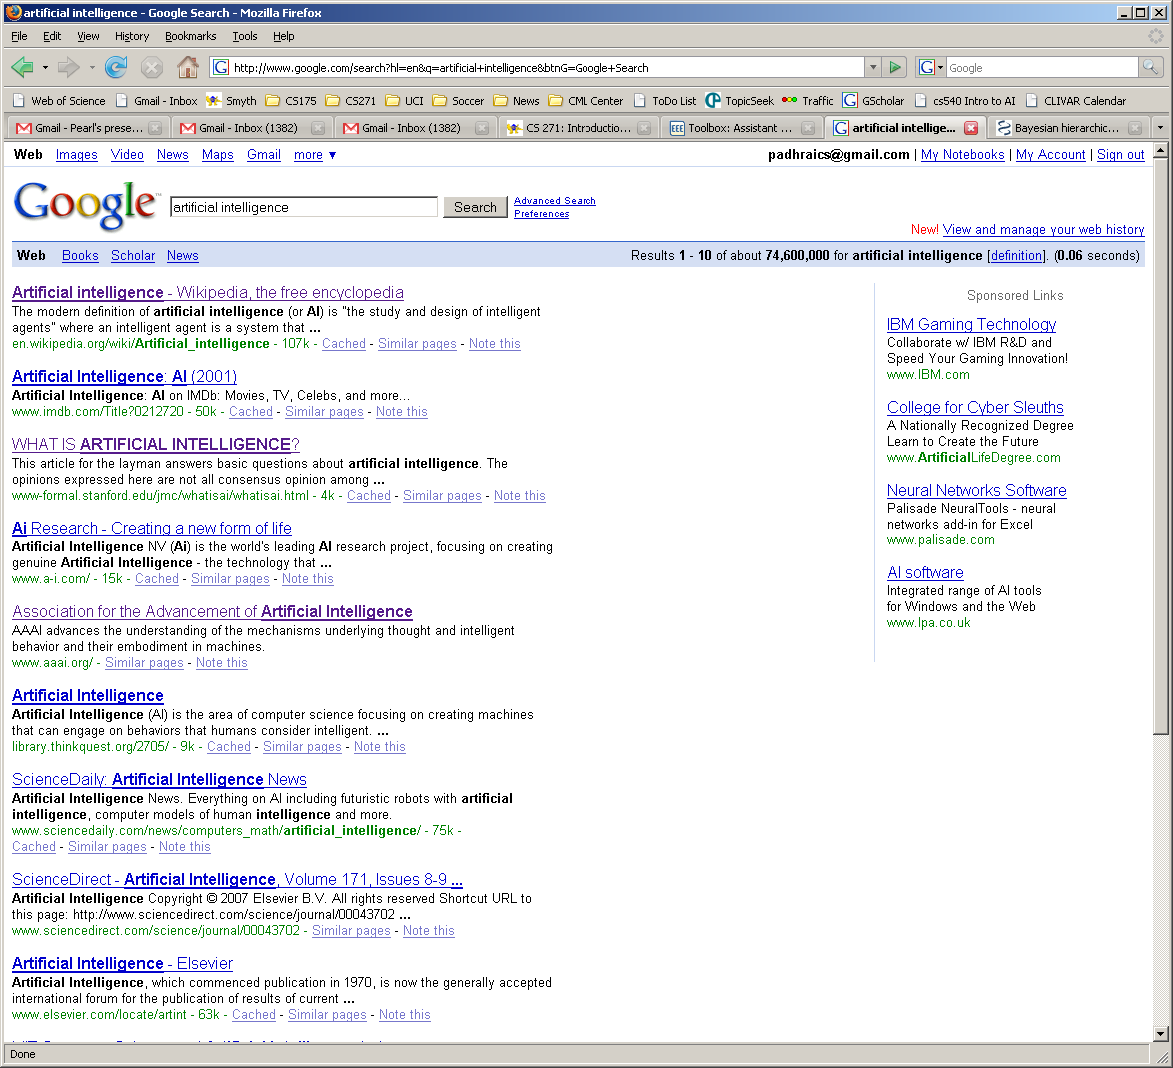
AI and Web Search
How do web-crawlers work?

Slide 39
What’s involved in Intelligence? (again)
Perceiving, recognizing, understanding the real world
Reasoning and planning about the external world
Learning and adaptation
So what general principles should we use to achieve these goals?

Slide 40
Characteristics of AI
Symbolic Processing
AI emphasizes manipulation of symbols rather than numbers.
The manner in which symbols are processed is non-algorithmic since most human reasoning process do not necessarily follow a step by step approach (algorithmic approach).
Heuristics
Are similar to rules of thumb where you need not rethink completely what to do every time a similar problem is encountered.
Inferencing
This is a form of reasoning with facts and rules using heuristics or some search strategies.

Slide 41
Characteristics of AI (2)
Pattern matching
A process of describing objects, events or processes in terms of their qualitative features and logical and computational relationships.
Knowledge Processing
Knowledge consists of facts, concepts, theories, heuristics methods, procedures and relationships.
Knowledge bases.
Collection of knowledge related to a problem.
Reasoning occurs based on this knowledge base.

Slide 42
Contrasting AI with Natural Intelligence
Important commercial advantages of AI are:-
AI is permanent as long as computer system and programs remain unchanged
AI offers ease of duplications and dissemination as compared to long apprenticeship for natural intelligence.
AI can be less expensive than natural intelligence.
AI being a computer system is consistent and thorough; natural intelligence may be erratic since people are erratic, they don’t perform consistently.
AI can execute certain tasks much faster than humans can.
AI can perform certain tasks better than many or even most people.

Slide 43
Contrasting AI with Natural Intelligence (2)
Natural Intelligence has the following advantages
Natural intelligence is creative, AI is uninspired- human always determine knowledge.
Natural intelligence enables people to benefit from use of sensory experience directly, while most AI systems must work with symbolic knowledge.

Slide 44
Different Types of Artificial Intelligence
Modeling exactly how humans actually think
Modeling exactly how humans actually act
Modeling how ideal agents “should think”
Modeling how ideal agents “should act”
Modern AI focuses on the last definition
we will also focus on this “engineering” approach
success is judged by how well the agent performs

Slide 45
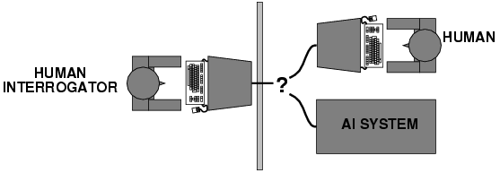
Acting humanly: Turing test
Turing (1950) "Computing machinery and intelligence“
"Can machines think?" → "Can machines behave intelligently?“
Operational test for intelligent behavior: the Imitation Game
Suggests major components required for AI:
- knowledge representation
- reasoning,
- language/image understanding,
- learning
* Question: is it important that an intelligent system act like a human?

Slide 46
Thinking humanly
Cognitive Science approach
Try to get “inside” our minds
E.g., conduct experiments with people to try to “reverse-engineer” how we reason, learning, remember, predict
Problems
Humans don’t always behave rationally
The reverse engineering is very hard to do
The brain’s hardware is very different to a computer program

Slide 47
Thinking rationally
Represent facts about the world via logic
Use logical inference as a basis for reasoning about these facts
Can be a very useful approach to AI
E.g., theorem-provers
Limitations
Does not account for an agent’s uncertainty about the world
E.g., difficult to couple to vision or speech systems
Has no way to represent goals, costs, etc (important aspects of real-world environments)

Slide 48
Acting rationally
Decision theory/Economics
Set of future states of the world
Set of possible actions an agent can take
Utility = gain to an agent for each action/state pair
An agent acts rationally if it selects the action that maximizes its “utility”
Or expected utility if there is uncertainty
Emphasis is on autonomous agents that behave rationally (make the best predictions, take the best actions)
on average over time
within computational limitations (“bounded rationality”)

Slide 49
Two Views of AI

Slide 50
Symbolic AI
Based on Newell & Simons Physical Symbol System Hypothesis
Uses logical operations that are applied to declarative knowledge bases (FOPL)
Commonly referred to as “Classical AI”
Represents knowledge about a problem as a set of declarative sentences in FOPL
Then logical reasoning methods are used to deduce consequences
Another name for this type of approach is called “the knowledge-based” approach
The Symbol Processing Approach uses “top-down” design of intelligent behavior.

Slide 51
Sub-symbolic Approach
Based on the Physical Grounding Hypothesis
“bottom-up” style
Starting at the lowest layers and working upward.
In the sub-symbolic approach signals are generally used rather than symbols
Proponents believe that the development of machine intelligence must follow many of the same evolutionary steps.
Sub-symbolic approaches rely primarily on interaction between machine and environment. This interaction produces and emergent behavior (evolutionary robotics, Nordin, Lund)
Some other sub-symbolic approaches are: Evolutionary Computation, Artificial Immune Systems, and Neural Networks

Slide 52
Turing Test for Intelligence
Tests the ability of a computer system to act humanly
The aim is to determine if the human interrogator thinks he/she is communicating with a human.
To pass Turing Test the computer must:
Process natural language;
Represent knowledge;
Reason;
Learn and adapt to the new situations.
Total Turing test included vision & robotics.

Slide 53
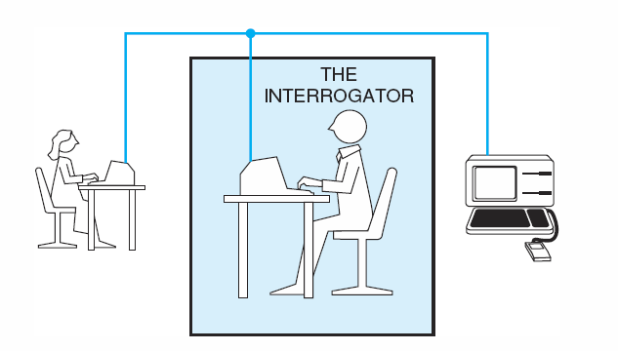
Turing Test (the Imitation game)- 1950

Slide 54
Modelling an AI System
A typical AI system consists of three subsystems, i.e.,
Perception Subsystem
Reasoning Subsystem
Action Subsystem(made of actuators/effectors)

Slide 55
AI Applications

Slide 56
AI application areas
Game Playing
Much of the early research in state space search was done using common board games such as checkers, chess, and the 15-puzzle
Games can generate extremely large search spaces. These are large and complex enough to require powerful techniques for determining what alternative to explore

Slide 57
AI application areas
Automated reasoning and Theorem Proving
Theorem-proving is one of the most fruitful branches of the field
Theorem-proving research was responsible in formalizing search algorithms and developing formal representation languages such as predicate calculus and the logic programming language

Slide 58
AI application areas
Expert System
One major insight gained from early work in problem solving was the importance of domain-specific knowledge
Expert knowledge is a combination of a theoretical understanding of the problem and a collection of heuristic problem-solving rules
Current deficiencies:
Lack of flexibility; if human cannot answer a question immediately, he can return to an examination of first principle and come up with something
Inability to provide deep explanations
Little learning from experience

Slide 59
AI application areas
Natural Language Understanding and Semantics
One of the long-standing goals of AI is the creation of programming that are capable of understanding and generating human language

Slide 60
AI application areas
Modeling Human Performance
Capture the human mind (knowledge representation)

Slide 61
AI application areas
Robotics
A robot that blindly performs a sequence of actions without responding to changes or being able to detect and correct errors could hardly be considered intelligent
It should have some degree of sensors and algorithms to guide it

Slide 62
AI application areas
Machine Learning
Learning has remained a challenging area in AI
An expert system may perform extensive and costly computation to solve a problem; unlike human, it usually doesn’t remember the solution
Examples include:
Decision tree learning
Genetic algorithms
Neural networks

Slide 63
Application Domains of AI
Application domain areas include:
Military
Medicine
Industry
Entertainment
Education
Business

Slide 64
Summary of Today’s Lecture
Intelligence and types
Artificial Intelligence involves the study of:
automated recognition and understanding of signals
reasoning, planning, and decision-making
learning and adaptation
AI has made substantial progress in
recognition and learning
some planning and reasoning problems
…but many open research problems
AI Applications
improvements in hardware and algorithms => AI applications in industry, finance, medicine, and science.
Rational agent view of AI
Two views of AI: symbol based vs. sub-symbolic AI Turing test for intelligence and AI applications

